Slide 1


Sreyas Institute of Engineering and Technology
An Autonomous Institution
Approved by AICTE, Affiliated to JNTUH
Accredited by NAAC-A Grade, NBA (CSE, ECE & ME) & ISO 9001:2015 Certified
DEPARTMENT OF ELECTRONICS & COMMUNICATION ENGINEERING
DRIVER DROWSINESS DETECTOR
UNDER THE GUIDANCE OF
Mrs. M. Pavani (Asst. prof)
Presented by A-16
P. Ganesh (22VE1A0447)
B. Bhavya Sirisha(22VE1A0407)
K. Chandu (22VE1A0423)

Slide 2
Abstract
Drowsiness is a major factor in road accidents.
The system monitors eye movements and facial expressions using computer vision.
Detects signs of fatigue in real time.
Alerts the driver through sound or vibration to prevent accidents.
Non-intrusive, low-cost, and easy to integrate into vehicles.
Aims to improve road safety with minimal hardware requirements.

Slide 3
Components Utilized
HARDWARE COMPONENTS:
IR blink sensor
Buzzer
Power Supply : Batteries.
Jumper Wires
Breadboard
ESP32-CAM
Spectacles
Data Cables
SOFTWARE COMPONENTS:
ESP32-CAM DRIVER MODULE
Arduino - IDE

Slide 4
Specifications
IR Sensor
Wavelength ~ 940 nm
Operating Voltage : 3.3V – 5V
Detection Range: 0.5cm – 3cm
ESP32 Cam
Flash Memor : 4 MB
SRAM ~ 520 KB
GPIO pins : 9
Operating Voltage : 3.3V
Power supply
Voltage input-5 volts
Regulated onboard to 3.3v
Used adapter
4

Slide 5
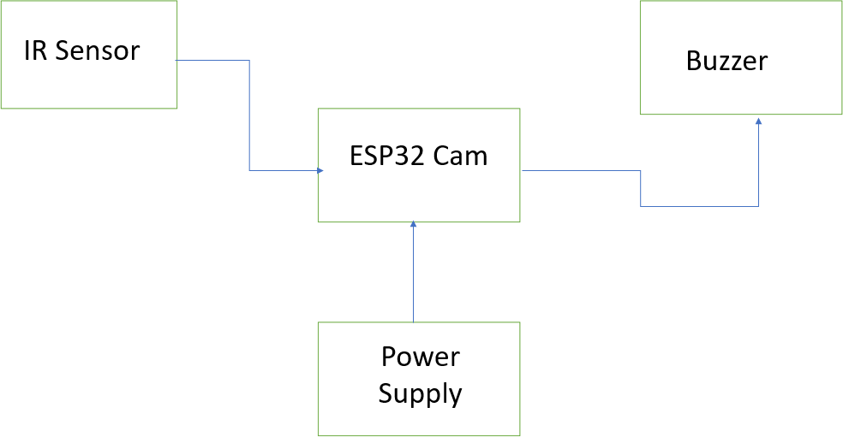
Block Diagram

Slide 6
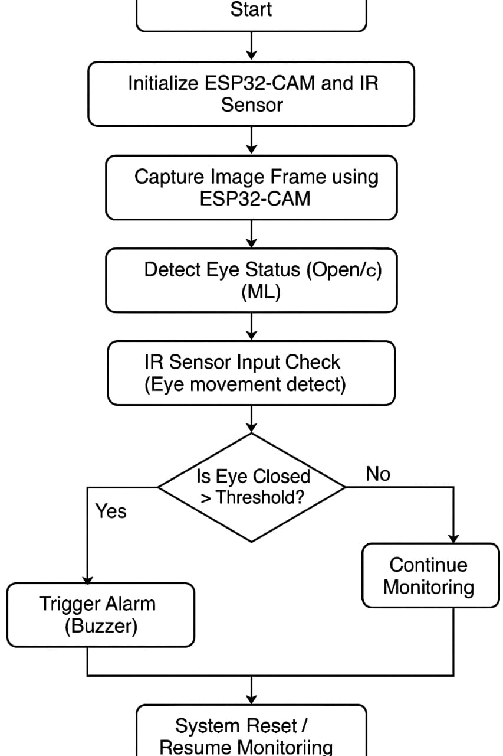
Flow Chart

Slide 7
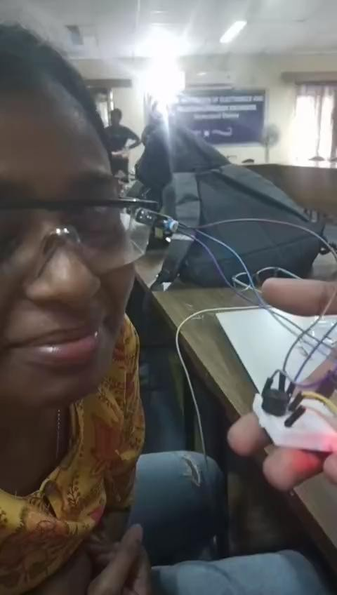
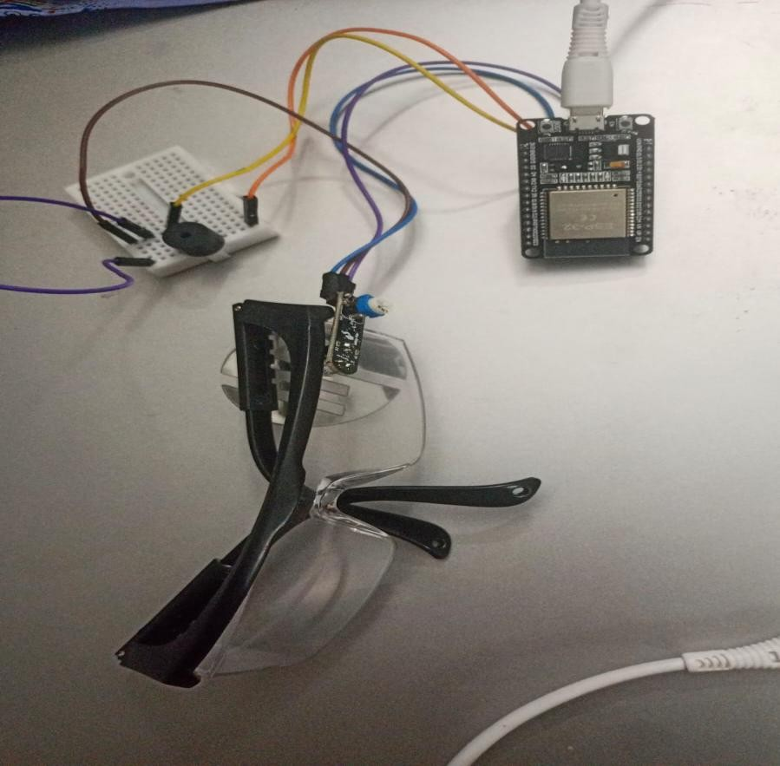
Simulation Results

Slide 8
Advantages & Applications
Advantages:
Accident Prevention: By detecting and alerting drivers to drowsiness, these systems can help prevent accidents caused by fatigue
Long-term Cost Savings : Reduced accident rates translate to lower insurance costs, vehicle repair expenses, and potential healthcare costs associated with accidents.
Improved Driver Performance: Drowsiness can impair reaction times, judgment, and focus.

Slide 9
Applications:
Real-time alerting: Notifies drivers if signs of drowsiness are detected.
Heavy machinery operators: Prevents accidents due to fatigue in industries like mining, construction, and agriculture.
Pilot fatigue management: Assists in alerting pilots during
long-haul flights.
8

Slide 10
Conclusion & Future Scope
Conclusion:
The Driver Drowsiness Detector helps prevent accidents by alerting drivers showing signs of fatigue.
It uses real-time face and eye monitoring, making it a practical and effective safety tool.
Future Scope:
Integrate with car systems for auto-response.
Add heart rate or motion sensors for better accuracy.
Improve performance in low light using IR cameras.
Develop mobile or dashcam-based versions.
Monitor distractions and emotions.
Use AI to adapt to different driver behaviors.

Slide 11
References
Real-time Eye Blink Detection Using Facial Landmarks https://www.researchgate.net/publication/304456047
Yawning Detection Using Embedded Smart Cameras
https://doi.org/10.1109/TIM.2014.2299031
Driver Drowsiness Detection Using Eye Blink Duration and Head Movement https://doi.org/10.1016/j.procs.2018.07.015
Driver Drowsiness Detection with Eyelid Related Parameters by Support Vector Machine https://doi.org/10.1016/j.eswa.2008.09.030

